Slide 1
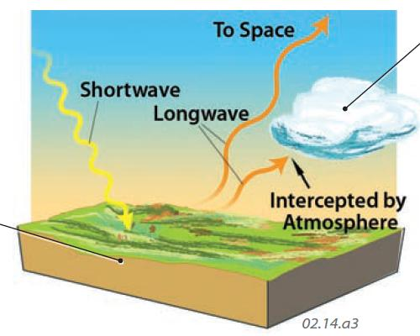
Recap: Simple Radiative Balance
ASR
OLR

Slide 2
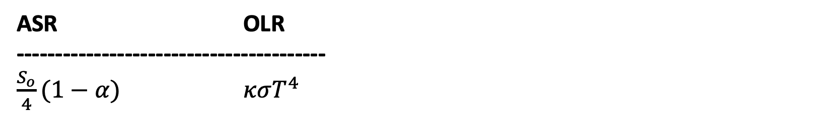
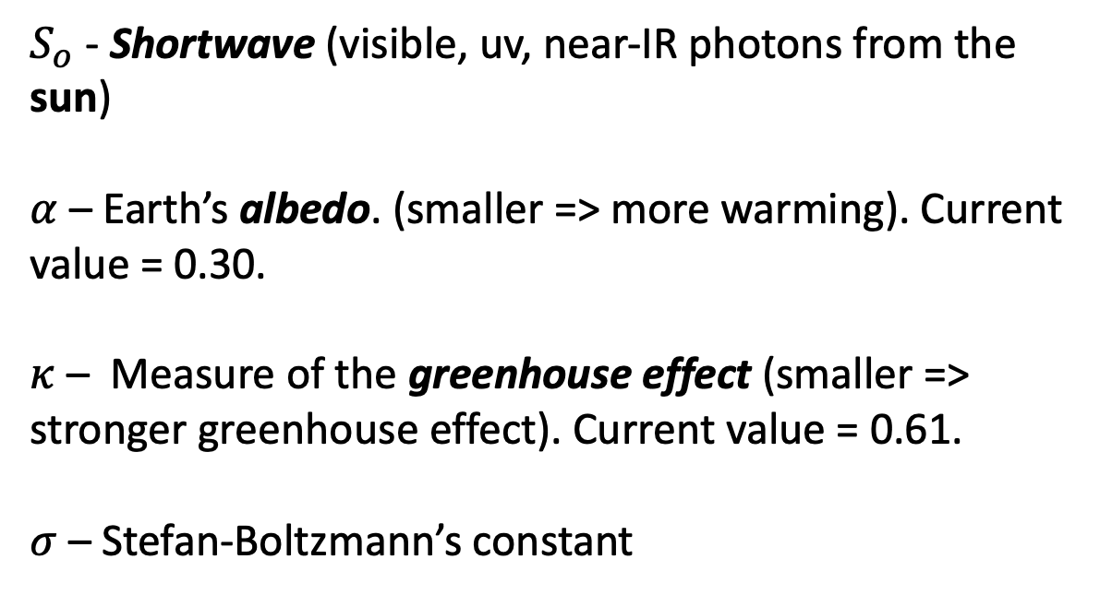
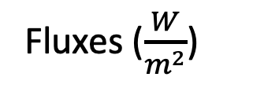

Slide 3

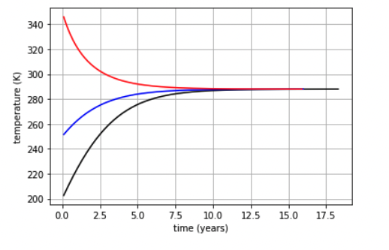
Recap: Simple Radiative Balance vocabulary: Homeostasis
Homeostasis
When ASR = OLR
Leads to the idea of a “Goldilocks Temperature”
Doesn’t depend on the earth’s starting temperature.

Slide 4
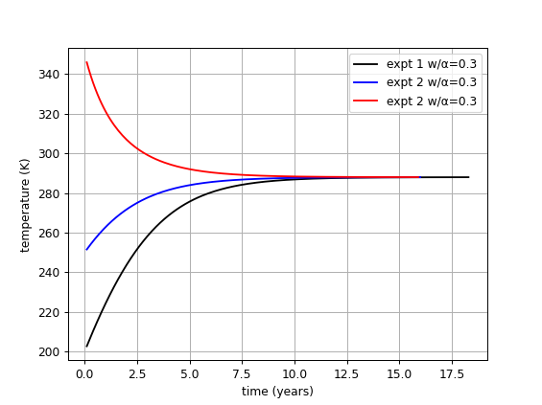
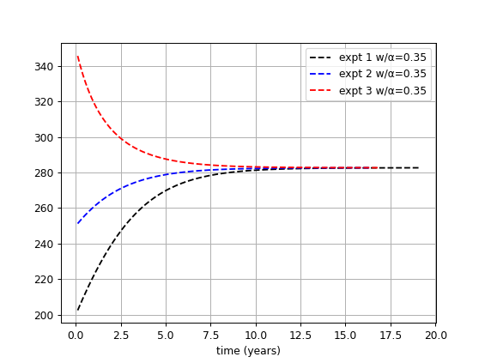
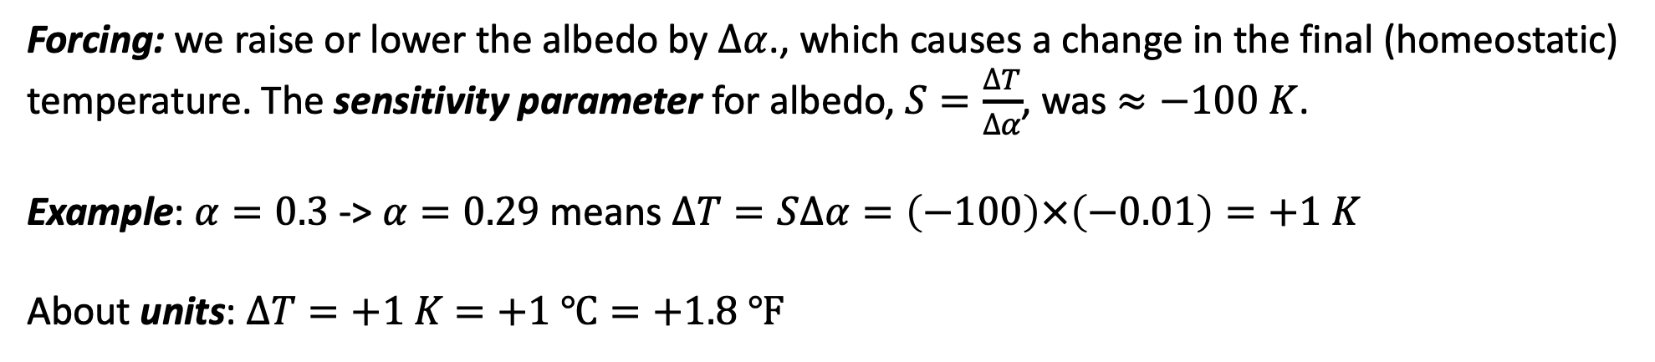
Recap: Climate sensitivity to forcings that result from changes in Earth’s albedo
T₁ ≈ 288 K
T₁ ≈ 283 K
Notes:
ΔT/Δα = (283 K - 288 K) / (0.35 - 0.3) = (-5 K)/(.05) = -100 K

Slide 5
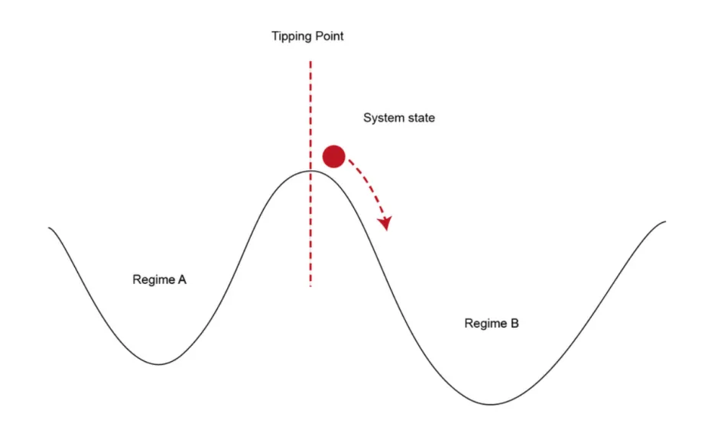
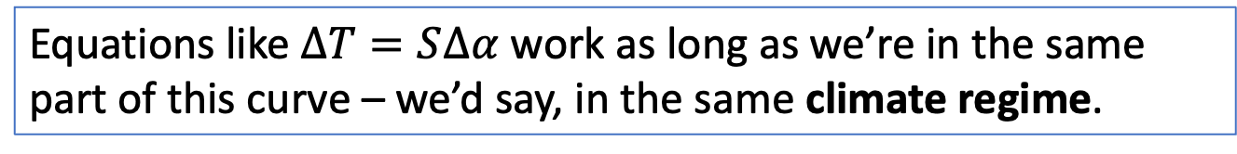
Pros and cons to predicting climate changes using a “Climate sensitivity” formulation like this
But as we get close to a tipping point, even tiny forcings can send us over into a new climate regime.
forcing
https://scied.ucar.edu/sites/default/files/styles/extra_large/public/images/tippingpoint_CC_rauter.png.webp?itok=jjVx9OvH

